Slide 1


New and Old book Purchase System (Web Application)
Detailed Project Report

Slide 2
Project Details
Project Title | New and Old book Purchase System (Web Application)
Technologies | Django
Domain | Ecommerce
Database | PostgreSQL
Front End | HTML , CSS, JavaScript, Bootstrap, Ajax

Slide 3
Objective
Develop a comprehensive web application that facilitates the buying and selling of both new and used books, providing users with a seamless experience for book discovery, purchase, selling, order tracking, payment processing, historical activity tracking, feedback submission, and community engagement.

Slide 4
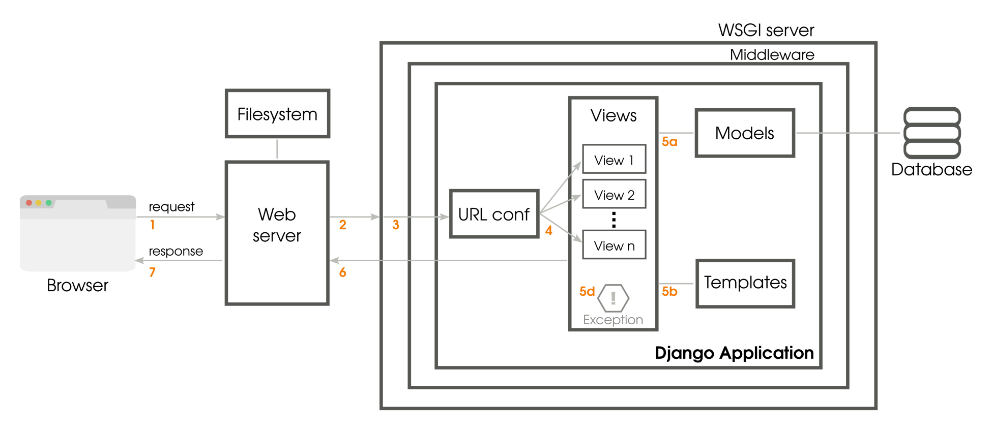
Architecture

Slide 5
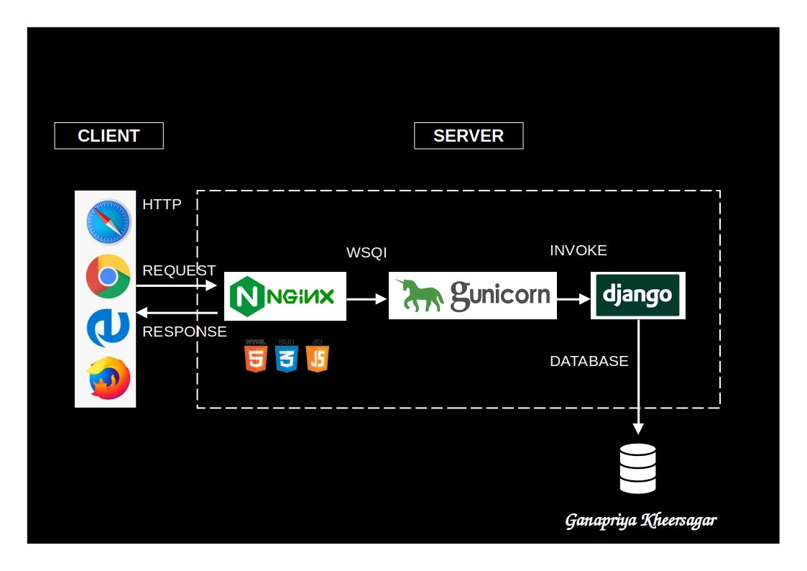
Application and web server architecture

Slide 6
Database
Dive into a seamless digital experience with our web app, where the dynamic prowess of PostgreSQL meets the unparalleled reliability of our locally deployed server. Empowering you with speed, security, and scalability, we've harnessed the best in database technology to redefine your online interactions. Explore the future of efficiency – try our web app now!

Slide 7
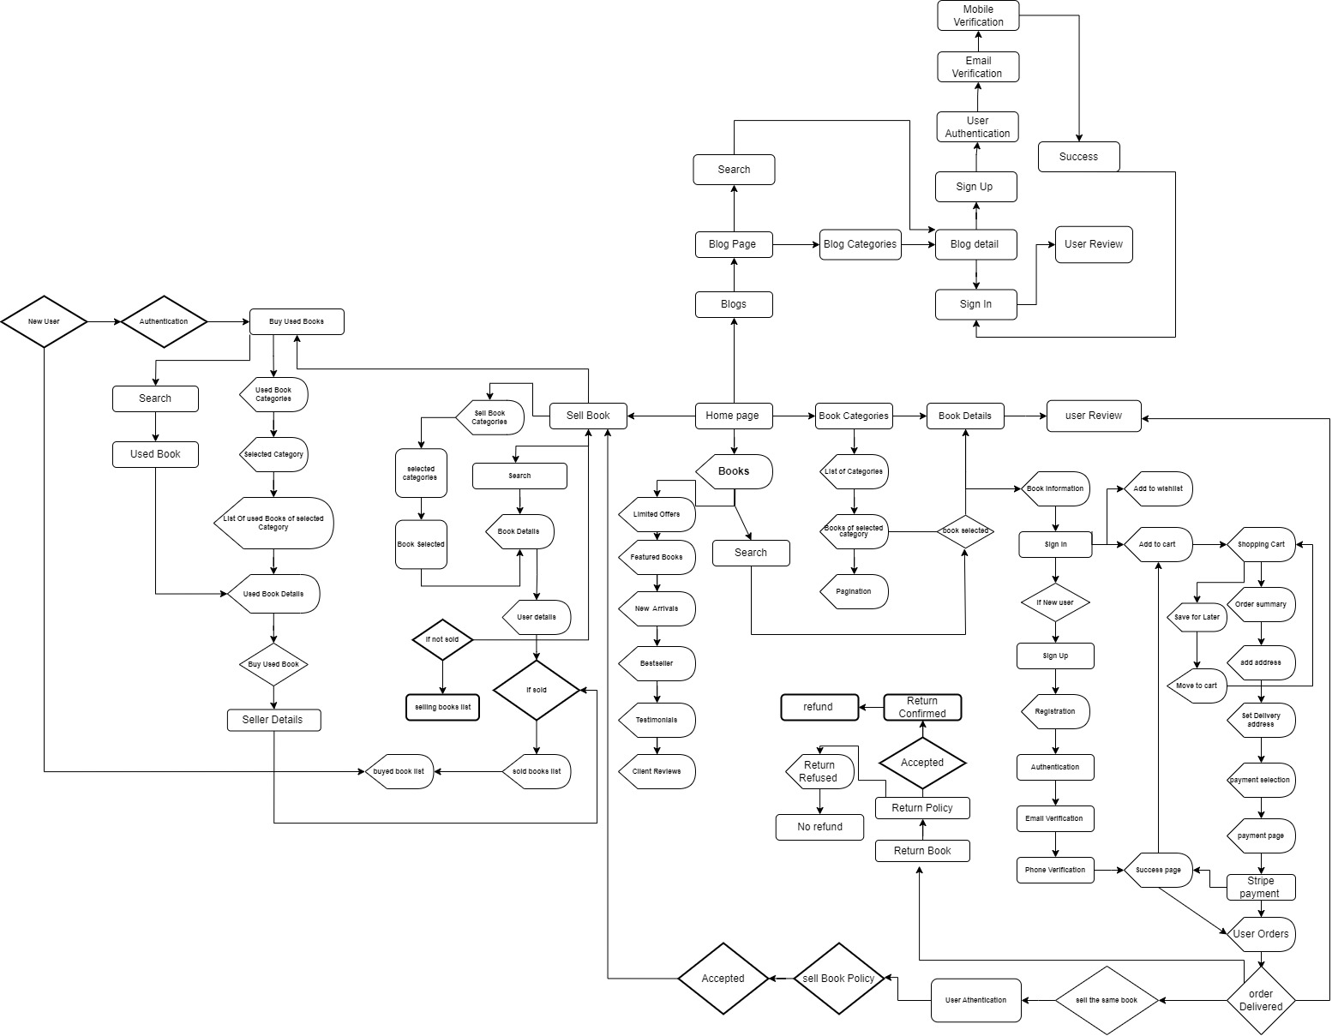
User Interface workflow

Slide 8
Deployment
Book Store is now live, utilizing the robust combination of Nginx and Gunicorn. Nginx ensures swift and smooth browsing, making book discovery a breeze. Gunicorn handles the application's dynamic features, guaranteeing secure and efficient transactions. Dive into Book Store for a seamless literary experience, where speed meets reliability.

Slide 9
Q & A
Q: What is the primary purpose of Book Store?
A: Book Store is a web application designed to provide users with a platform for buying and selling books, fostering a community of readers. It offers a seamless experience for discovering, purchasing, and selling both new and pre- loved books.

Slide 10
Q & A
Q: How can I get started on Book Store? A: To begin using Book Store, you can create a personalized account on the platform. Once registered, you can explore the extensive book catalog, make purchases, sell your completed books, track orders, and engage in reader discussions.

Slide 11
Q & A
Q: Can I sell my used books on Book Store?
A: Absolutely! Book Store allows users to easily upload and sell their pre-loved books. This feature not only provides users with an opportunity to pass on books they've completed but also helps build a sustainable community of book enthusiasts.

Slide 12
Q & A
Q: How does the order tracking feature work on Book Store?
A: Book Store's order tracking feature allows users to monitor the status of their book orders in real-time. From the moment of purchase to delivery, users can stay informed about the progress of their orders through an intuitive tracking system.

Slide 13
Q & A
Q: Is the payment process secure on Book Store?
A: Yes, Book Store ensures a secure payment process through the trusted Stripe payment gateway. Users can make transactions with confidence, knowing that their financial information is handled with the utmost security and reliability.

Slide 14
Q & A
Q: What database technology does Book Store use?
A: Book Store utilizes PostgreSQL, a robust and open-source relational database management system. This ensures secure and efficient data storage, contributing to the reliability and performance of the Book Store web application.

Slide 15
Q & A
Q: Can I provide feedback for the books I've read on Book Store?
A: Certainly! Book Store encourages users to share their thoughts and experiences by providing feedback and ratings for each book. This not only helps fellow readers but also contributes to building a vibrant and informed community.

Slide 16
Q & A
Q: Are there any historical tracking features on Book Store?
A: Yes, Book Store keeps a comprehensive history of your interactions on the platform. Users can access details of past transactions, sales, and discussions, providing a holistic view of their engagement with the application.

Slide 17
Q & A
Q: How can I engage with other readers on Book Store?
A: Book Store facilitates reader discussions on various topics, ranging from book recommendations to broader literary conversations. Users can actively participate, share insights, and connect with like-minded readers within the community.
Feel free to customize these questions and answers based on any additional features or specifics of your web app.

Slide 18
conclusion
Book Store has successfully addressed the challenges outlined in our problem statement, delivering a user-friendly platform for buying and selling books. With streamlined processes, secure transactions via Stripe, and efficient data management with PostgreSQL, Book Store provides a seamless experience.
The innovative feature allowing users to sell purchased books within a specified timeframe adds a dynamic edge to the community. Historical tracking, feedback options, and reader discussions contribute to the overall vibrant user experience.
Book Store remains committed to providing a hassle-free and enjoyable platform for book enthusiasts. As we continue to grow and evolve, we look forward to maintaining our position as a preferred destination for online book interactions. Happy reading!

